Slide 1
DOES 16: Handling Security Objections To DevOps
Hart Rossman
hart@ or @HartDanger
June, 2016

Slide 2
Telling The Story & Showing Results
Establish a vision and tell the story
Build an enterprise-wide agile security culture
Start with the customer and work backwards
Provide examples through consultation & code
Build a metrics dashboard
Celebrate success & learn from mistakes

Slide 3


Security program – Ownership as part of DNA
Distributed
Embedded
Promotes culture of “everyone is an owner” for security
Makes security stakeholder in business success
Enables easier and smoother communication
Notes:
Culture – you can disagree about architecture, but apathy is unacceptable

Slide 4
Operating with Shared Responsibility
Responsibility & Accountability
How do I know?
Own it.
Govern it.
Not my monkeys; not my circus.
Do I carry a pager for this service?
Do I make the rules?
Should I be consulted or informed?

Slide 5
Security as code: Innovation, stability, & security
Business
Build it faster
Keep it stable
Protect it
Development
Security
Operations
Notes:
With our current organization structures and processes, Development and IT operations can be siloes having different: goals
Developers are paid to change things i.e. write code,
Ops folks are paid to NOT change things and keep things stable

Slide 6
Security as code: Deploying more frequently lowers risk
Rare release events:
“Waterfall methodology”
Frequent release events:
“Agile methodology”
Change
Change
Time
Time
Larger effort
“Increased risk”
Smaller effort
“Minimized risk”
Notes:
In the Waterfall model most of us cut out teeth on, change is a big deal. You don’t want to do it often, and when you do it, you will spend a few weeks doing an impact analysis. You absolutely want to make sure it doesn’t fail, or you will spend the next few months filling out Post Incident Reports…in triplicate. And before starting on the paper work you will need to roll the system back to its last know working configuration. These were the days teams of people were standing up monoliths in Easter island
In agile methodology change is almost a non event that is embraced. You contain the risk by making incrementally small changes.
So Agile methodology must be the state of nirvana! …Maybe if you are a developer. Not if you are Ops

Slide 7
Security as code: A shorter path to the customer
Lots of learning
Requirements
Gathering
Automated Build and Deploy
Release
Minimal learning
Some learning

Slide 8
Security as code
Use the cloud to protect the cloud
Security infrastructure should be cloud aware
Expose security features as services via API
Automate everything so everything scales
Notes:
1.Use the cloud to protect the cloud; Use the cloud to protect the DC; Build and Deploy the same way your business apps do
2. API’s are your contracts with business partners and those you protect. Make it easy to include security in deployments and the business will
3. No chokepoints or bottlenecks. Everything must scale to keep pace with the business.

Slide 9

Continuous Integration
Repo
Package Builder
Config
Code
Config
Tests
Push
Version Control
CI Server
Commit to
Git/master
Get / Pull
Code
Dev
Distributed Builds
Run Tests in parallel
Send Build Report to Dev
Stop everything if build failed

Slide 10
What does CI give us?
Confidence that our code changes will build successfully
Increasing velocity of feedback cycle through iterative change
Bugs are detected quickly
Automated testing reduces size of testing effort
Very fast feedback on the things we can test immediately

Slide 11
Continuous Delivery
CloudFormation
Templates for Env
Repo
Generate
Package Builder
Config
Install
Create
AMIs
Code
Config
Tests
Push
Test Env
Version Control
CI Server
Deploy Server
Staging Env
Commit to
Git/master
Get / Pull
Code
Dev
Prod Env
Distributed Builds
Run Tests in parallel
Send Build Report to Dev
Stop everything if build failed

Slide 12
What does CD give us?
Automated, repeatable process to push changes to production
Hardens, de-risks the deployment process
Allows detection of failure as quickly as possible in the build process
Supports A/B testing or “We test customer reactions to features in production”
Gives us a breadth of data points across our applications

Slide 13
DevSecOps: Core Principles
Secure the toolchain
Armor up the workloads
Deploy your security infrastructure through the toolchain

Slide 14

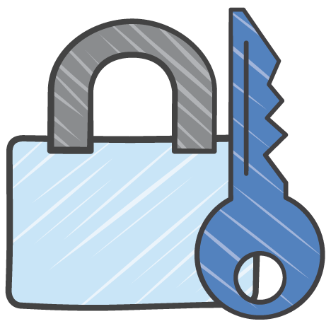
DevOps→ DevSecOps
AWS CloudFormation
templates for Env
Repo
Generate
Vulnerability and pen testing
Security services
Deployments
Package Builder
Config
Install
Create
Code
Config
Tests
Security Repository
AMIs
Push
Test Env
Version Control
CI Server
Deploy Server
Staging Env
Pull
Code
Commit to
repo
Prod Env
Dev
Security Infrastructure tests
Security unit tests in app
Send build report to dev and
stop everything if build failed

Slide 15
Building DevSecOps teams
Make DevOps the security team’s job.
No siloed/walled off DevOps teams.
Encourage {security} developers to participate openly in the automation of operations code.
Embolden {security} operations participation in testing and automation of application code.
Take pride in how fast and frequently you deploy.

Slide 16
Key security enablers
Cloud Security Strategy
Security Operations Playbook & Runbooks
Stakeholder Communication Plan
Security Cartography
Document Shared Responsibility Model
Security Epics Plan
Security Incident Response Simulation
Milestones that help you stay on track

Slide 17
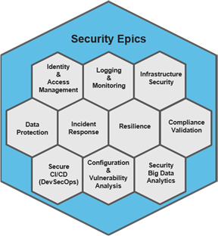
Security Epics
To structure a program of work we identify ten themes, as illustrated in diagram below. When treated as Epics in an agile methodology, these contain the user stories including both use cases & abuse cases. Frequent iteration via sprints will lead to increase maturity whilst retaining flexibility to adapt to business pace and demand.
1st Sprint Example
Define the account structure and implement the core set of best practices
2nd Sprint Example
Implement federation
3rd Sprint Example
Expand account management to cater for multiple accounts
You can build capability in parallel or serial fashion and maintain flexibility by including security capability user stories in the overall product backlog or splitting them out into a security focused DevOps team. These are decisions you can periodically revisit, allowing you to tailor your delivery to the needs of the organization over time.

Slide 18
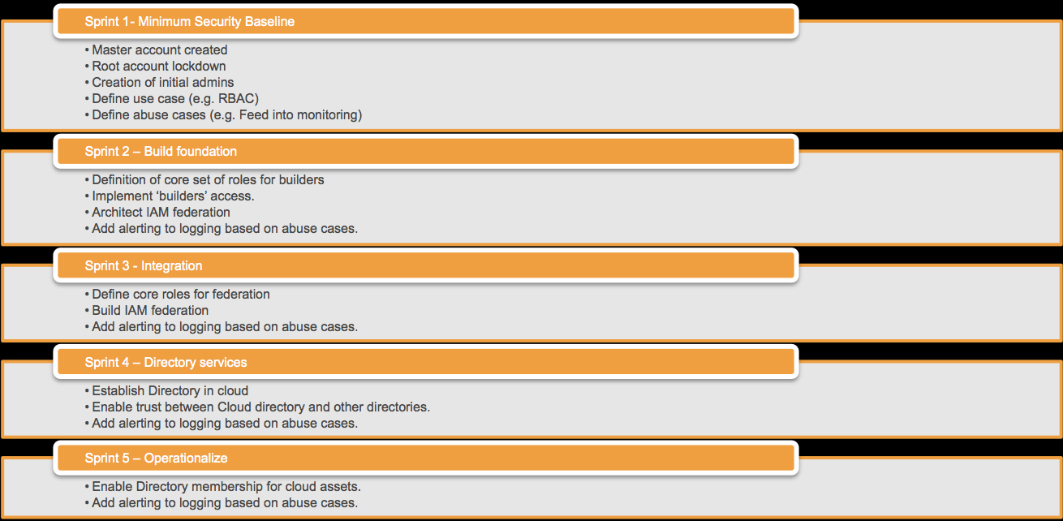
Sample IAM epic
Sprint 1 for IAM can consist of defining the account structure and implement the core set of best practices. A second sprint can implement federation. A third sprint can expand account management to cater for multiple accounts and so on.
IAM user stories that may span one or more of these initial sprints could include stories such as:
“As an access administrator, I want to create an initial set of users for managing privileged access and federation identity provider trust relationships”
“As an access administrator, I want to map users in my existing corporate directory to functional roles or sets of access entitlements on AWS platform.”
“As an access administrator, I want to enforce multi-factor authentication on all interaction with the AWS console by interactive users.”

Slide 19
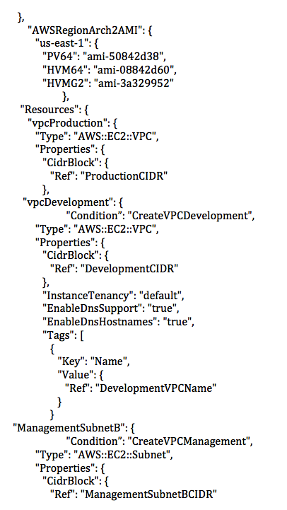
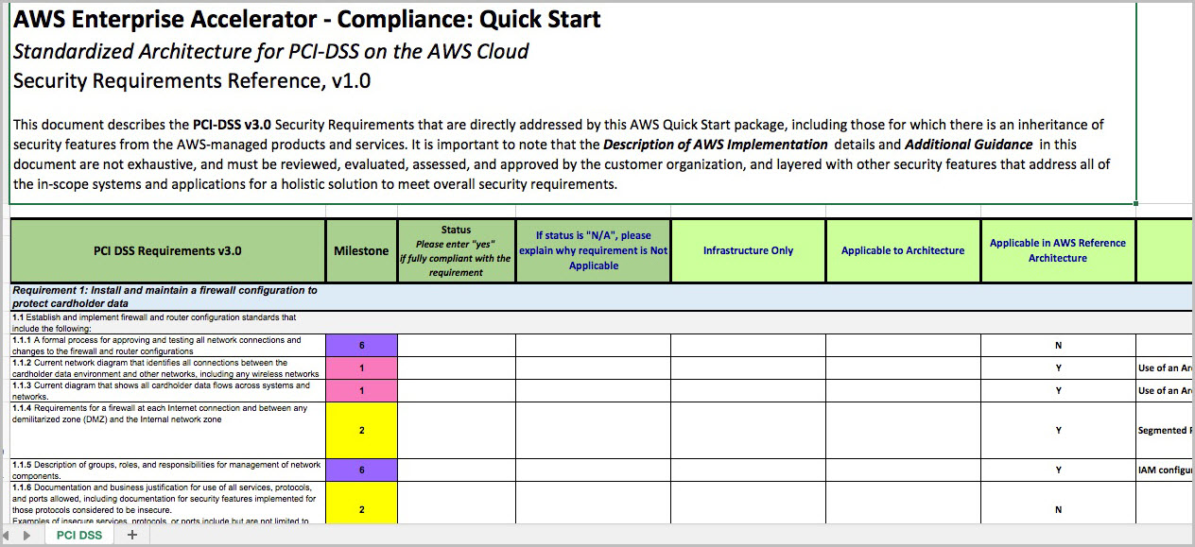
Security Cartography: Mapping the Landscape
What you do in any IT Environment
Code translation
Firewall rules
Network ACLs
Network time pointers
Internal and external subnets
NAT rules
Gold OS images
Encryption algorithms for data in transit and at rest
http://docs.aws.amazon.com/quickstart/latest/accelerator-nist/welcome.html
Gold Image, NTP and NAT
Network ACLs, Subnets, FW rules
http://docs.aws.amazon.com/quickstart/latest/accelerator-pci/welcome.html
Notes:
First, a little background. Traditional security frameworks, regulation and organizational policies define several security perimeters related to a number of things: Firewall rules, Network Access Controls, Internal/External subnets, Operating Systems Hardening and the use of encryption at-rest or in-transient.
These are all implemented into an AWS environment as well. The SbD approach enables organization to script these types of baseline configurations into a “Golden Environment”. Creating golden environment within AWS can help organizations set up baseline security and compliance elements, which each customer environments should implement similarly as they would in an on-premise environment.
As you can see within the call outs; the CF templates defines the use of operating systems, network access control and network time protocol. Additionally, the second call out defines Network ACLs, subnets, and firewall rules.

Slide 20
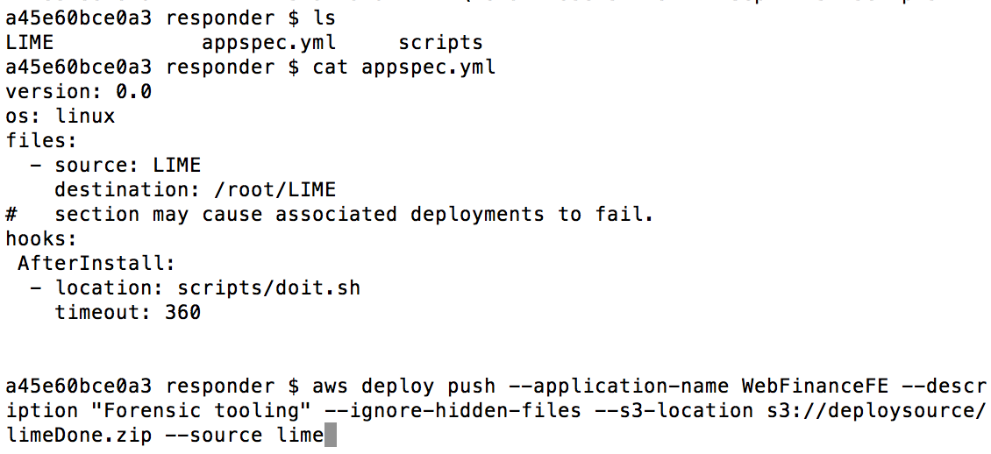
Security As Code: Using AWS CodeDeploy
Imaging instance memory:
LiME - https://github.com/504ensicslabs/lime
AWS CodeDeploy:

Slide 21
Planetary Scale from Day 1
Build Security Services
Expose features as API
Plan for Scale
Know your Customers
Utilize customer feedback to Iterate
Internalize your Metrics, let them guide you

Slide 22

Get Started Today!
Make DevOps the security team’s job
Harden your toolchain
Plan your Security Epics
Write your first Security User Story
Sprint!
hart@
@HartDanger

